Slide 1

NSI TEACH
Cybersecurity & AI Clinic
Student Information Session
George Mason University Scalia Law School · Howard University School of Business

Slide 2

Why This Clinic Exists
Cyber threats increasingly affect small businesses, nonprofits, schools, and community organizations — yet many lack resources for implementing meaningful cybersecurity measures.
Students interested in law, policy, and technology need practical experience with real cybersecurity and AI governance challenges.
This clinic bridges that gap.
Students learn cybersecurity and AI governance while providing real supervised legal services to Washington-area organizations — combining classroom learning with hands-on professional client work.

Slide 3
A Growing Field: Cybersecurity + AI Governance
Demand for cybersecurity and AI governance expertise is expanding across every sector.
Law Firms
Consulting
Tech Companies
Government
Nonprofits & NGOs
Cyber risk counsel
& data privacy practice
Security advisory
& compliance work
Cyber + AI policy &
governance roles
National security
& cyber policy
Digital resilience
& data protection
We are a member of the Consortium of Cybersecurity Clinics: A 50+ network cybersecurity clinics operating globally. Our clinic is among the first to integrate AI governance and policy.

Slide 4
Program Structure: Two Semesters
Foundations in the fall. Real client engagement in the spring.
FALL SEMESTER — Foundations of Cyber Practice
SPRING SEMESTER — Client Engagement
Cybersecurity risk management frameworks
Threat actors, vectors & vulnerabilities
Organizational risks through a legal lens
Incident response planning
Data governance & AI governance
In-class exercises & out of class assignments
Evaluation of cyber governance policies
Work with a real client organization
Conduct a full cybersecurity risk assessment
Develop mitigation recommendations
Draft cybersecurity & AI governance policies
Deliver a professional advisory report
Present findings to client leadership

Slide 5

Fall Semester — Building Foundations
Topics students learn:
Legal and policy concepts in cybersecurity and AI risk governance
Common & emerging cyber threats facing organizations
Risk management frameworks
Identifying & analyzing organizational vulnerabilities
Incident response planning & analysis
Applications of AI in cybersecurity & AI governance
Work includes:
Reviewing statutes, regulations, case law, reg enforcement actions
Analyzing governance frameworks and organizational policies
Applying legal frameworks to real-world organizational scenarios
Completing short legal analysis assignments and policy review exercises

Slide 6
Clinic vs. Cyber Law: What's the Difference?
Cyber Law
This Clinic and the Fall Semester
Covers legal doctrine — the CFAA, surveillance law, Fourth Amendment cases, federal regulatory frameworks
Studies cases and incidents that already happened
Asks: what does the law say? When does it apply?
Teaches the rules of the legal landscape
Learn key federal statutes, regulations, agency enforcement actions, and foundational case law
Teaches you how to operate inside that landscape on behalf of a real client
Asks: what does this specific organization need to do?
Teaches the practice of cybersecurity counseling
Both are valuable — but they are not interchangeable. In our program’s fall semester, you read statutes and cases and then apply them to real organizations — not to litigate disputes or to evaluate whether a framework applies, but to advise clients on how to comply with the law and manage risk.

Slide 7
Spring Semester — Real Client Engagements
Each student team produces a full Cybersecurity + AI Risk Assessment for a real organization.
Client Questionnaire
Cyber Risk Register
Preliminary Assessment Brief
Tailored fact-finding questionnaire covering governance, operations, technology, and vendors
Prioritized inventory of threats and vulnerabilities assessed for legal liability and business impact
Mid-semester summary of priority risk findings and direction of recommendations to stress test with client
Final Report
Cybersecurity Policies
AI Governance Assessment
Full assessment covering legal risk and liability exposure, prioritized mitigation recommendations, and an AI readiness and governance review
Draft tailored governance-level policies including information security policy and incident response plan
Evaluation of existing and potential client AI use cases and associated legal, operational, and governance risks
All recommendations are designed to be practical, implementable, and tailored to each organization's size and resources.

Slide 8

What the Spring Week Looks Like
Students should expect a meaningful time commitment, similar to other clinical programs, but it does look different. The spring semester is the most intensive.
Typical weekly expectations:
Weekly class session (mix of in person and virtual)
Weekly incremental assignments and deliverable drafts
Multitasking and multitracking
Internal team collaboration meetings
Client meetings throughout the spring semester
A key skill of the clinic: managing multiple deliverables and timelines simultaneously — exactly as you would in practice.

Slide 9
Clients Students Have Worked With
Student teams have served real organizations across the Washington metropolitan area, including:
Arlington Free Clinic
Bread for the City
Healthcare nonprofit
Social services nonprofit
Cybersecurity risk assessment, incident response plan, and information security policies for a community health clinic serving uninsured patients.
Full cyber + AI risk assessment, data governance review, and operational security recommendations for a major DC social services provider.
Digital Pioneers Academy
Center for Youth & Family Advocacy
Public charter school
Community advocacy nonprofit
Cybersecurity posture assessment and AI readiness review for a technology-focused K-12 charter school.
Risk register, cybersecurity policies, and AI governance framework for a DC-area family services organization.

Slide 10
How This Clinic Differs from Other Law Clinics
Other law clinics...
In this clinic, you...
✕ Litigation-based work
✕ A lot case law & regulations analysis
✕ Representing a client in court
✕ Drafting pleadings & legal arguments
✕ Relying on already-completed discovery
✓ Proactively counsel a client to avoid legal exposure
✓ Conduct your own discovery & information gathering
✓ Translate legal exposure into governance & operational recommendations
✓ Produce real deliverables a client will act on
✓ Lead the client engagement end-to-end
✓ Work in areas of law and policy that are not yet settled
→

Slide 11

What It Actually Looks Like
You walk in with a real client — a nonprofit health clinic or a charter school. Your job: figure out where they are exposed, how serious it is, and what they should do about it.
1
Apply a real framework
Use NIST CSF to guide a full assessment of the org's systems, people, and processes — not analyzing it on paper but deploying it on a live engagement.
2
Do your own fact-gathering
Talk to the IT director, legal counsel, and operations staff. Find out what tech they use, how they handle data, what vendors can access. Nobody hands you a record.
3
Translate findings into risk and recommendations
Apply legal analysis to produce a prioritized set of risks and actionable recommendations — framed in language leadership can understand and act on
4
Draft real governance documents
Develop client tailored policies, including information security policy, incident response plan, and AI use policy.

Slide 12
Faculty & Practitioner Instructors
Students work with instructors drawn from leading law firms, major technology companies, and government — practitioners doing this work every day.
Attorney Instructors from
All Instructor Organizations
Cooley LLP
Troutman Pepper Locke
Crowell & Moring
IBM
Meta
Government agencies , eg (DoJ)
Google
Freddie Mac
BNY
Beacon Global Strategies
Amgen
E Cyber7 Technologies
Techstars
Each team has 3–4 dedicated instructors who lead class sessions, review all work products, and provide continuous written feedback throughout the semester.

Slide 13
Program Logistics
Credits & Degree
Schedule
Student Support
3 credits each semester (6 credits total)
Counts toward National Security Law & Cybersecurity Law concentrations (JD)
Counts toward Cyber, Intelligence & National Security LLM
Fall 2026: In person at GMU Arlington (Fuse), Tuesdays 4–6 PM
Spring 2027: Virtual weekly + 3–4 in-person sessions at GMU Fuse
1–2 mandatory on-site client visits in spring
Financial support provided each semester
Free Google Cybersecurity Professional Certificate
CompTIA Security+ exam voucher

Slide 14
Skills Students Gain
Students leave with a portfolio of real work products and practical experience valued across law, tech, government, and consulting.
Cyber Risk Management
AI Governance & Policy
Client Advisory Work
Applying NIST CSF and other frameworks to assess and prioritize organizational risk
Identifying AI use cases and associated legal, operational, and governance risks
Real stakeholder engagement and professional consulting communication
Policy Drafting
Technical Translation
Professional Deliverables
Writing cybersecurity policies, incident response plans, and compliance guidance
Converting complex cyber risks into clear legal and operational recommendations
A portfolio of published-quality reports, policies, and frameworks

Slide 15
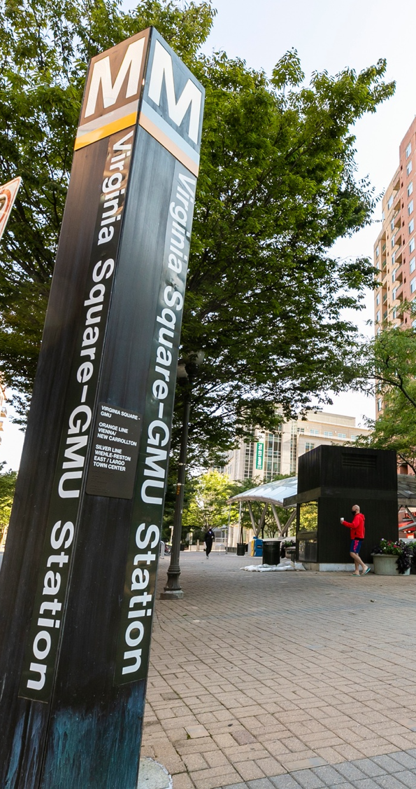
How to Apply
Application Requirements
Resume
Statement of interest (under 750 words)
Unofficial grade transcript
Important Notes
No previous cybersecurity experience required
One-year commitment required (both semesters)
Selected applicants will be interviewed before final decisions
Applications submitted earlier receive priority consideration
Apply at the National Security Institute website · Questions: jjones76@gmu.edu

Slide 16

Questions?
Email: jjones76@gmu.edu
Apply at the National Security Institute website
NSI TEACH Cybersecurity & AI Clinic · George Mason University Scalia Law School · Howard University School of Business

