Slide 1
CISA: Mission, Authorities, and Capabilities
Office of the General Counsel

Slide 2
Composition of our Client
6 USC §652(f) Composition
The Cybersecurity Division, headed by an Assistant Director. [6 U.S.C. §653] The NCCIC is located in CISA and the head of the NCCIC reports to the Assistant Director for Cybersecurity. 6 USC §659(b)
(2) The Infrastructure Security Division, headed by an Assistant Director. [6 USC §654]
(3) The Emergency Communications Division under subchapter XIII, headed by an Assistant Director. [6 USC §571]
* National Risk Management Center (NRMC)
The Agency shall be composed of the following divisions:

Slide 3
CISA Cybersecurity Responsibilities
Information sharing and technical assistance involving federal and non-federal entities
Protecting federal, civilian, executive-branch agencies
Coordinating the federal government’s response to incidents
3

Slide 4
Cybersecurity Division’s Main Activities and Programs
INFORMATION SHARING
INSTRUMENTING
ASSESSING
DIRECTING
RESPONDING AND RECOVERY
UNCLASSIFIED // FOR OFFICIAL USE ONLY

Slide 5
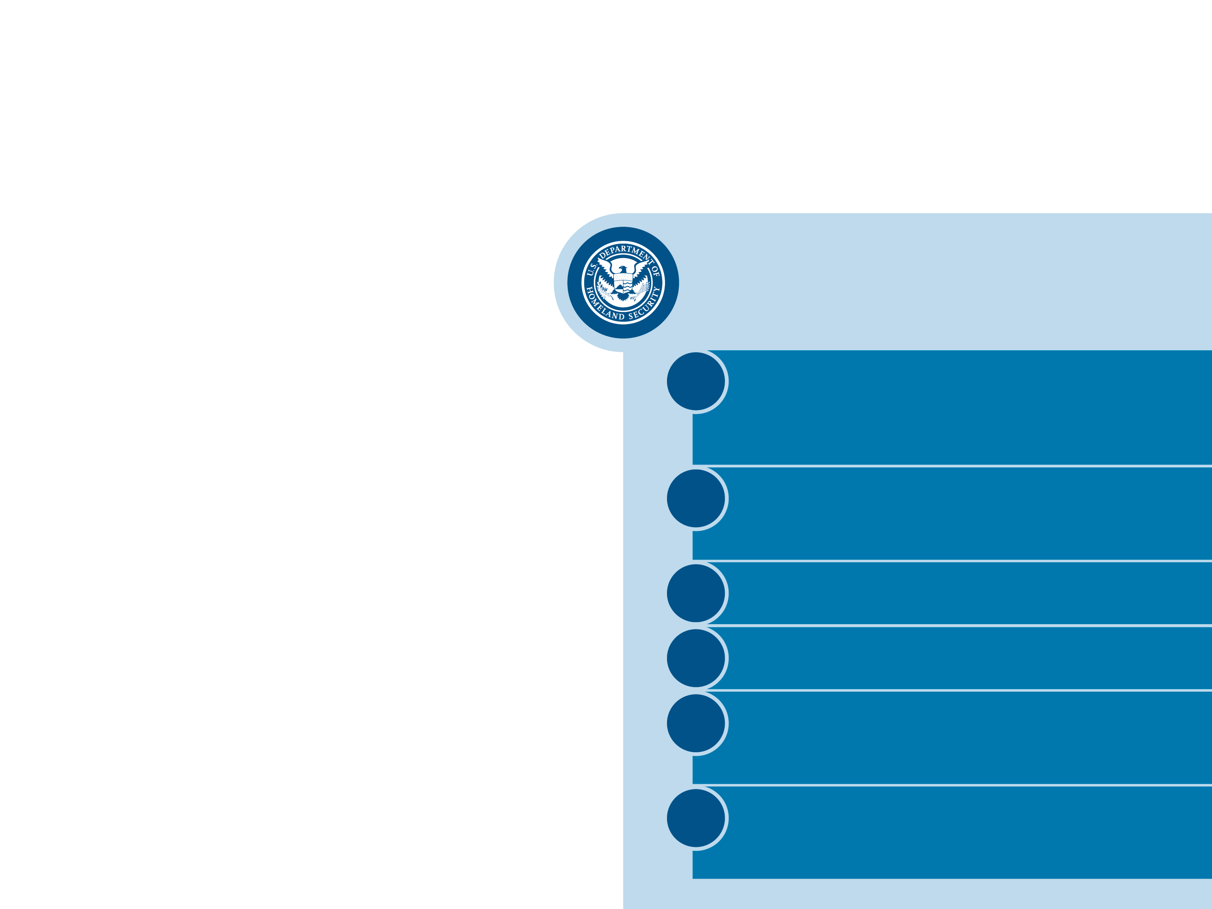
CISA’s Cybersecurity Authorities
The Homeland Security Act of 2002
Subtitle A of Title XXII
Multiple sources of authority and direction,
but here are some primary examples:
1
Section 2209 National cybersecurity and communications integration center (6 U.S.C. § 659)
2
Section 2205- Enhancement of Federal and Non-Federal Cybersecurity (6 U.S.C. § 655)
3
Section 2202 (6 U.S.C. § 652)
4
Section 2210- Cybersecurity plans (6 U.S.C. § 660)
5
Section 2213 Federal intrusion detection and prevention system (6 U.S.C. § 663 & 663 note)
6
Section 2208 Cybersecurity recruitment and retention (6 U.S.C. § 658)
5

Slide 6
CISA’s Cybersecurity Authorities
The Cybersecurity Information Sharing Act of 2015
6 U.S.C. §§ 1501-1510
Critical Infrastructure Information Act, Title II, Part B of Pub. L. No. 107-296
6 U.S.C. § 673
Multiple sources of authority and direction,
but here are some primary examples:
Federal Acquisition Supply Chain Security Act of 2018, Title II of Pub. L. No.115-390
41 U.S.C. §§ 1321-1328
Subchapter II of Chapter 35 of Title 44
(created by the Federal Information Security Modernization Act of 2014 (FISMA))
Presidential Policy Directive 41, United States Cyber Incident Coordination
(July 27, 2016)
Presidential Policy Directive 21, Critical Infrastructure Security and Resilience
(2013)
6

Slide 7
CISA Cybersecurity Responsibilities
Information sharing and technical assistance involving federal and non-federal entities
Protecting federal, civilian, executive-branch agencies
Coordinating the federal government’s response to incidents
7

Slide 8
Information Sharing and Technical Assistance Involving Federal and Non-Federal Entities
What CISA does:
CISA is authorized to share information related to cybersecurity risks and incidents, and provide technical assistance upon request
With whom CISA interacts:
At its sole and unreviewable discretion, CISA engages with all stakeholders – federal and non-federal entities, including international partners – and coordinates information sharing.
Mechanisms for action:
To fulfill its cybersecurity functions, CISA enters into information sharing relationships and agreements, and operates the NCCIC.
8

Slide 9
Information Sharing and Technical Assistance Involving Federal and Non-Federal Entities
The Homeland Security Act of 2002 | Section 2209 6 U.S.C. §659
The NCCIC has explicit authority to:
RECEIVE information relating to cybersecurity risks and incidents. 6 U.S.C. § 659(c)(1)
ANALYZE and INTEGRATE “including cross-sector integration and analysis, of cyber threat indicators, defensive measures, cybersecurity risks, and incidents.” 6 U.S.C. § 659(c)(5)(A)
DISSEMINATE “cyber threat indicators, defensive measures, and other information related to cybersecurity risks and incidents with Federal and non-Federal entities” and for providing guidance and recommendations
Accepting this guidance is voluntary as no private entity is required “to implement any measure or recommendation suggested by the Secretary.” Pub. L. No. 113-282, § 8(b)(2), 128 Stat. 3066, 3072(2014) (codified at 6 U.S.C. § 659, note) (Rules of Construction))
9

Slide 10
Information Sharing and Technical Assistance Involving Federal and Non-Federal Entities
Cybersecurity Information Sharing Act of 2015 | 6 U.S.C. §§ 1501-10
Non-federal entities can share cyber threat indicators (CTIs) and defensive measures (DMs) notwithstanding any other law. 6 U.S.C. § 1503(c).
Requires removal of certain personal information. 6 U.S.C. § 1503(d)(2).
DHS develops a capability and process that accepts Cybersecurity Threat Indicators and Defensive Measures from any non-Federal entity and by which the Federal Government receives Cybersecurity Threat Indicators and Defensive Measures. 6 U.S.C. § 1504
10

Slide 11
Support national level enterprise risk management through information sharing
INFORMATION SHARING
Automated Indicator Sharing (AIS)
Bi-directional, machine-speed sharing of threat indicators
Enhanced Cybersecurity Services (ECS)
Intrusion detection/prevention system with government information (classified and unclassified) to augment organization’s capabilities
Cyber Information Sharing and Collaboration Program (CISCP)
Public-private information sharing group
CYBERSECURITY IS A TEAM SPORT
CONTACT: ncciccustomerservice@hq.dhs.gov
UNCLASSIFIED // FOR OFFICIAL USE ONLY
Notes:
Automated Indicator Sharing (AIS)
With AIS, DHS leverages machine-to-machine communication to rapidly share cyber threat indicators with partners in the federal government, SLTT governments, information sharing and analysis organizations/centers (ISAO/ISACs), and private-sector critical infrastructure stakeholders. AIS connects participating organizations to a DHS-managed system that allows automated bi-directional sharing of anonymized cyber threat indicators in real (or near-real) time.
Cyber Information Sharing and Collaboration Program (CISCP)
Through CISCP, DHS and participating companies share information about cyber threats, incidents, and vulnerabilities. Participants are better equipped to secure their own networks and analysts learn from each other about understand emerging cybersecurity risks and effective defenses.
Enhanced Cybersecurity Services (ECS)
ECS is an intrusion detection and prevention capability available to U.S.-based entities and SLTT governments. ECS follows a managed security service model whereby DHS shares sensitive and classified cyber threat information with accredited ECS commercial service providers. These commercial service providers in turn use that information to detect and block malicious traffic from entering or exiting customer networks depending on the service.

Slide 12
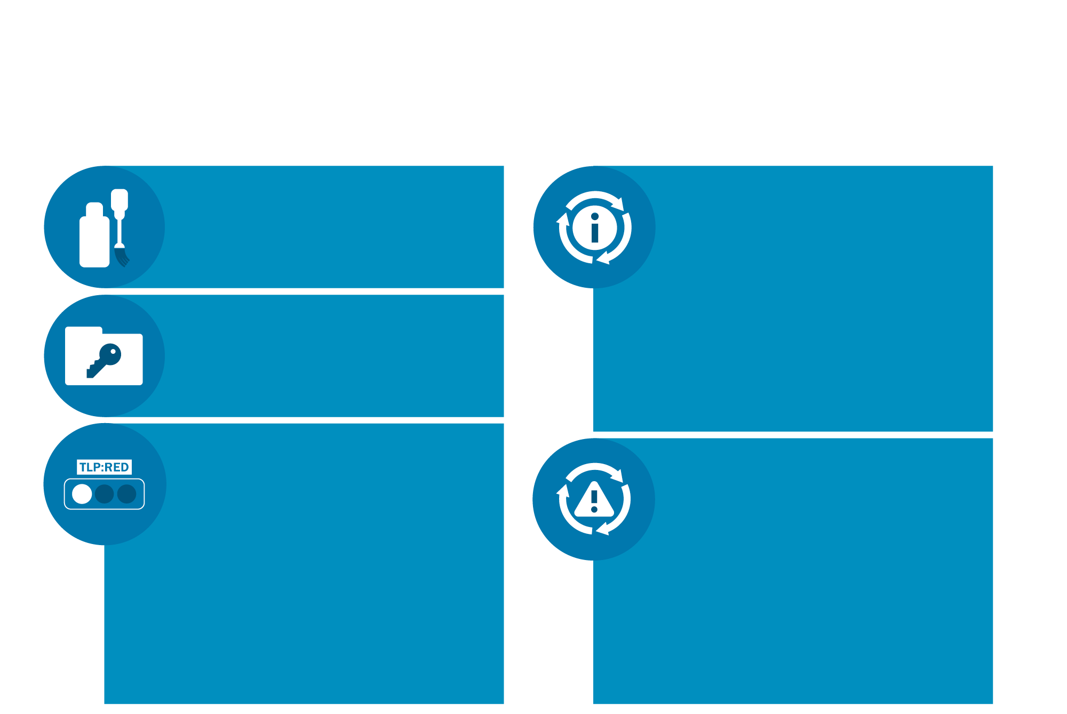
How We Protect Information
Information shared through CISCP/AIS is sanitized to protect stakeholders’ identities.
Stakeholders that share information with or receive technical assistance from the NCCIC may invoke Protected Critical Infrastructure Information (PCII) protections. https://www.dhs.gov/ pcii-program
CSD will not disclose information that is exempt from disclosure under FOIA
Sharing of that information is governed using the Traffic Light Protocol (TLP). Shared information is made available to the limited sharing community through the HSIN. https://www.first.org/tlp
Stakeholders that share information with the NCCIC are eligible for certain protections under CISA so long as the stakeholder meets certain requirements. See detailed guidance at https://us-cert.gov/ais
12

Slide 13
Information Sharing and Technical Assistance Involving Federal and Non-Federal Entities
The Homeland Security Act of 2002 | Section 2209 6 U.S.C. §659
The NCCIC is authorized to provide timely technical assistance, risk management support, and incident response capabilities to Federal and non-Federal entities with respect to cyber threat indicators, defensive measures, cybersecurity risks, and incidents, which may include attribution, mitigation, and remediation.” 6 U.S.C. § 659(c)(6);
Technical assistance includes:
Connecting to entities’ networks
Providing vulnerability assessments
Scanning those networks
Deploying technical capabilities during an incident
13

Slide 14
Help non-Federal entities assess their cybersecurity posture
The Cyber Resilience Review (CRR)
The External Dependencies Management (EDM)
The Cyber Infrastructure Survey (CIS)
The Phishing Campaign Assessment (PCA)
Vulnerability scanning (formerly known as Cyber Hygiene scanning)
The Validated Architecture Design Review (VADR)
The Cyber Security Evaluation Tool (CSET)
ASSESSING
CONTACT: ncciccustomerservice@hq.dhs.gov
UNCLASSIFIED // FOR OFFICIAL USE ONLY
Notes:
Automated cyber hygiene scans offer an objective view of an agency’s or critical infrastructure stakeholder’s cybersecurity posture.
Risk and Vulnerability Assessments (RVA) combine national-level threat and vulnerability information to provide agency-specific risk analyses and remediation recommendations.
Design and Security Architecture Reviews analyze the cybersecurity design, engineering, and architecture of Federal and industrial control system networks.
Cyber Resilience Reviews (CRR) evaluate an organization’s operational resilience and cybersecurity practices.
Information Security Continuous Monitoring (ISCM) assessments provide assistance in remediating gaps in ISCM programs and promote the concept of near real-time risk management.

Slide 15
Support intrusion analysis and mitigation
Incident Response Teams provide intrusion analysis and mitigation guidance to requesting entities
Hunt and Incident Response Teams (HIRT)
RESPONSE AND RECOVERY
Incident triage
Network topology review
Log analysis
Incident specific risk overview
Hunt analysis
Malware analysis
Mitigation
Digital media analysis
Control systems incident analysis
CONTACT: ncciccustomerservice@hq.dhs.gov
UNCLASSIFIED // FOR OFFICIAL USE ONLY
Notes:
Hunt and Incident Response Teams (HIRT)
Provide intrusion analysis and mitigation guidance to clients who lack in-house capability or require additional assistance
Perform on-site and remote response services
Engagements include log, network traffic, and host analysis
Rapid response teams (deployed within eight hours) are available
National Coordinating Center (NCC)
Leads effort to ensure resilient National Security and Emergency Preparedness (NS/EP)
Advises the President on NS/EP communications decisions during a national emergency
Supports Emergency Support Function #2 under the National Response Framework

Slide 16
CISA Cybersecurity Responsibilities
Information sharing and technical assistance involving federal and non-federal entities
Protecting federal, civilian, executive-branch agencies
Coordinating the federal government’s response to incidents
16

Slide 17
Protecting federal, civilian, executive-branch agencies
Subchapter II of Chapter 35 of Title 44 (created by the Federal Information Security Modernization Act of 2014 (FISMA))
OMB oversees agency information security policy and practices. 44 U.S.C. § 3553(a).
DHS/CISA administers the implementation of agency information security policies and practices in consultation with OMB. 44 U.S.C. § 3553(b).
Commerce/NIST issues standards and guidance tied to FISMA. 44 U.S.C. §§ 3553-54; see also 40 U.S.C. § 11331a.
Agencies provide information security protections commensurate with the risk to agency information and information systems and in compliance with OMB policy, DHS directives, and NIST standards. 44 U.S.C. § 3554. (In DHS, the CIO fills this role).

Slide 18
Protecting federal, civilian, executive-branch agencies
CISA operates a federal information security incident center within the NCCIC and receives reports of cybersecurity incidents. 44 U.S.C. § 3553(b)(6)(A).
The Department’s federal information security authorities apply to only federal civilian Executive Branch agencies, with important exclusions.
CISA administers the implementation of government-wide cybersecurity policies.
CISA deploys technology, including the Continuous Diagnostics and Mitigation (CDM) Program and EINSTEIN
CISA issues directives
18

Slide 19
Detect and prevent cybersecurity threats from compromising Federal agency networks
INSTRUMENTING
National Cybersecurity Protection System (NCPS)
Detects and blocks known malicious traffic using classified information
Detects and alerts on known malicious traffic
Detects characteristics of internet traffic to and from agencies
E1
E2
E³A
UNCLASSIFIED // FOR OFFICIAL USE ONLY
Notes:
National Cybersecurity Protection System (NCPS)
Provides DHS with the situational awareness to use threat information detected in one agency to protect the rest of the government.
Einstein’s capabilities grew, strengthening outer defenses that detect and stop adversaries going in or coming out of agency networks. Einstein 1 detects characteristics of Internet traffic to and from agencies, while Einstein 2 detects and alerts on known malicious traffic. Einstein 3 takes it a step further, detecting and blocking known malicious traffic using classified information.
Continuous Diagnostics and Mitigation (CDM)
Delivers tools, sensors, and integration services to enhance the cybersecurity hygiene of federal government networks
Provides a Federal-wide view of the .gov cybersecurity posture, enabling coordinated and improved federal cybersecurity response capabilities

Slide 20
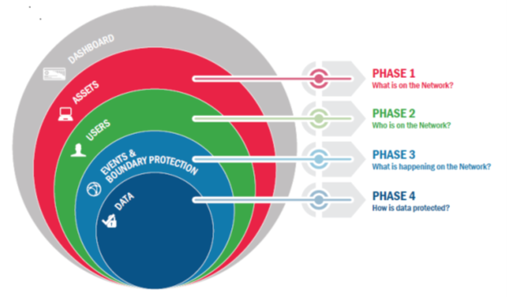
Detect and prevent cybersecurity threats from compromising Federal agency networks
INSTRUMENTING
Continuous Diagnostics and Mitigation (CDM)
UNCLASSIFIED // FOR OFFICIAL USE ONLY
Notes:
National Cybersecurity Protection System (NCPS)
Provides DHS with the situational awareness to use threat information detected in one agency to protect the rest of the government.
Einstein’s capabilities grew, strengthening outer defenses that detect and stop adversaries going in or coming out of agency networks. Einstein 1 detects characteristics of Internet traffic to and from agencies, while Einstein 2 detects and alerts on known malicious traffic. Einstein 3 takes it a step further, detecting and blocking known malicious traffic using classified information.
Continuous Diagnostics and Mitigation (CDM)
Delivers tools, sensors, and integration services to enhance the cybersecurity hygiene of federal government networks
Provides a Federal-wide view of the .gov cybersecurity posture, enabling coordinated and improved federal cybersecurity response capabilities

Slide 21
Binding Operational Directives (BOD) and Emergency Directives (ED)
BOD 15-01, Critical Vulnerability Mitigation Requirements for Federal Civilian Executive Branch Departments and Agencies’ Internet-Accessible Systems (May 21, 2015)
BOD 16-01, Securing High Value Assets (June 9, 2016)
BOD 16-02, Threat to Network Infrastructure Devices (Sept. 27, 2016)
BOD 16-03, 2016 Agency Cybersecurity Reporting Requirements (Oct. 17, 2016)
BOD 17-01 Removal of Kaspersky-Branded Products (82 Fed.Reg. 43782, Sept. 19, 2017)
BOD 18-01 Enhance Email and Web Security (October 16, 2017)
BOD 18-02 Securing High Value Assets (May 7, 2018)
ED 19-01: Mitigate DNS Infrastructure Tampering (January 22, 2019)
FOR MORE INFORMATION: https://cyber.dhs.gov/directives

Slide 22
Protecting federal, civilian, executive-branch agencies
OMB leads the Federal Acquisition Security Council. 41 U.S.C. § 1322(c).
DHS/CISA participates on the Council, issues exclusion and removal orders, and assists agencies with requirements to improve their management of supply chain risks. 41 U.S.C. §§ 1323(c); 1326(d).
Federal Acquisition Security Council establishes criteria for information sharing and recommends government-wide exclusions and removals of products. 41 U.S.C. §1323. OMB (chair), GSA, DHS, DNI, DOJ, Commerce. 41 U.S.C. §1322(b).
Agencies develop an overall supply chain management strategy and implementation plan and are authorized to mitigate or take procurement actions to address supply chain risks as part of FISMA responsibilities. 41 U.S.C. § 1326; 47 U.S.C. § 4713 (In DHS, the CIO fills this role).
Subchapter III of Chapter 13 of Title 41 (created by the Federal Acquisition Supply Chain Security Act of 2018)

Slide 23
CISA Cybersecurity Responsibilities
Information sharing and technical assistance involving federal and non-federal entities
Protecting federal, civilian, executive-branch agencies
Coordinating the federal government’s response to incidents
23

Slide 24
Coordinating the federal government’s response to incidents
Actual Coordination.
See 6 U.S.C. § 659; 44 U.S.C. § 3553; PPD-41.
CISA has a coordinating role in the context of the “unity of effort within the Federal Government” and the “close coordination between the public and private sectors” in responding to cybersecurity incidents.
Planning Documents and Exercises.
See 6 U.S.C. § 660; PPD-41.
As part of its coordination efforts, the Department is also charged with developing, maintaining, updating, and exercising cyber incident response plans—including “the National Cybersecurity Incident Response Plan” and the Cyber Incident Annex to the National Response Framework.
Leveraging Support from Other Agencies.
See EO 12333; PPD-41; DSCA
During a cybersecurity incident, the Department is authorized to leverage certain Presidential authorities, as well as request technical assistance from the Intelligence Community and support from the Department of Defense (DOD).
24

Slide 25
Coordinating the federal government’s response to incidents
PPD-41 FOR SIGNIFICANT INCIDENTS
Lead Federal Agencies for the three lines of effort:
Coordination Architecture Entities
The NCCIC for asset response
The Cyber Response Group (CRG) for National Policy
Per-incident Cyber Unified Coordination Groups (UCGs) for National Operational Coordination
FBI and NCIJTF for threat response
ODNI for intelligence support

Slide 26
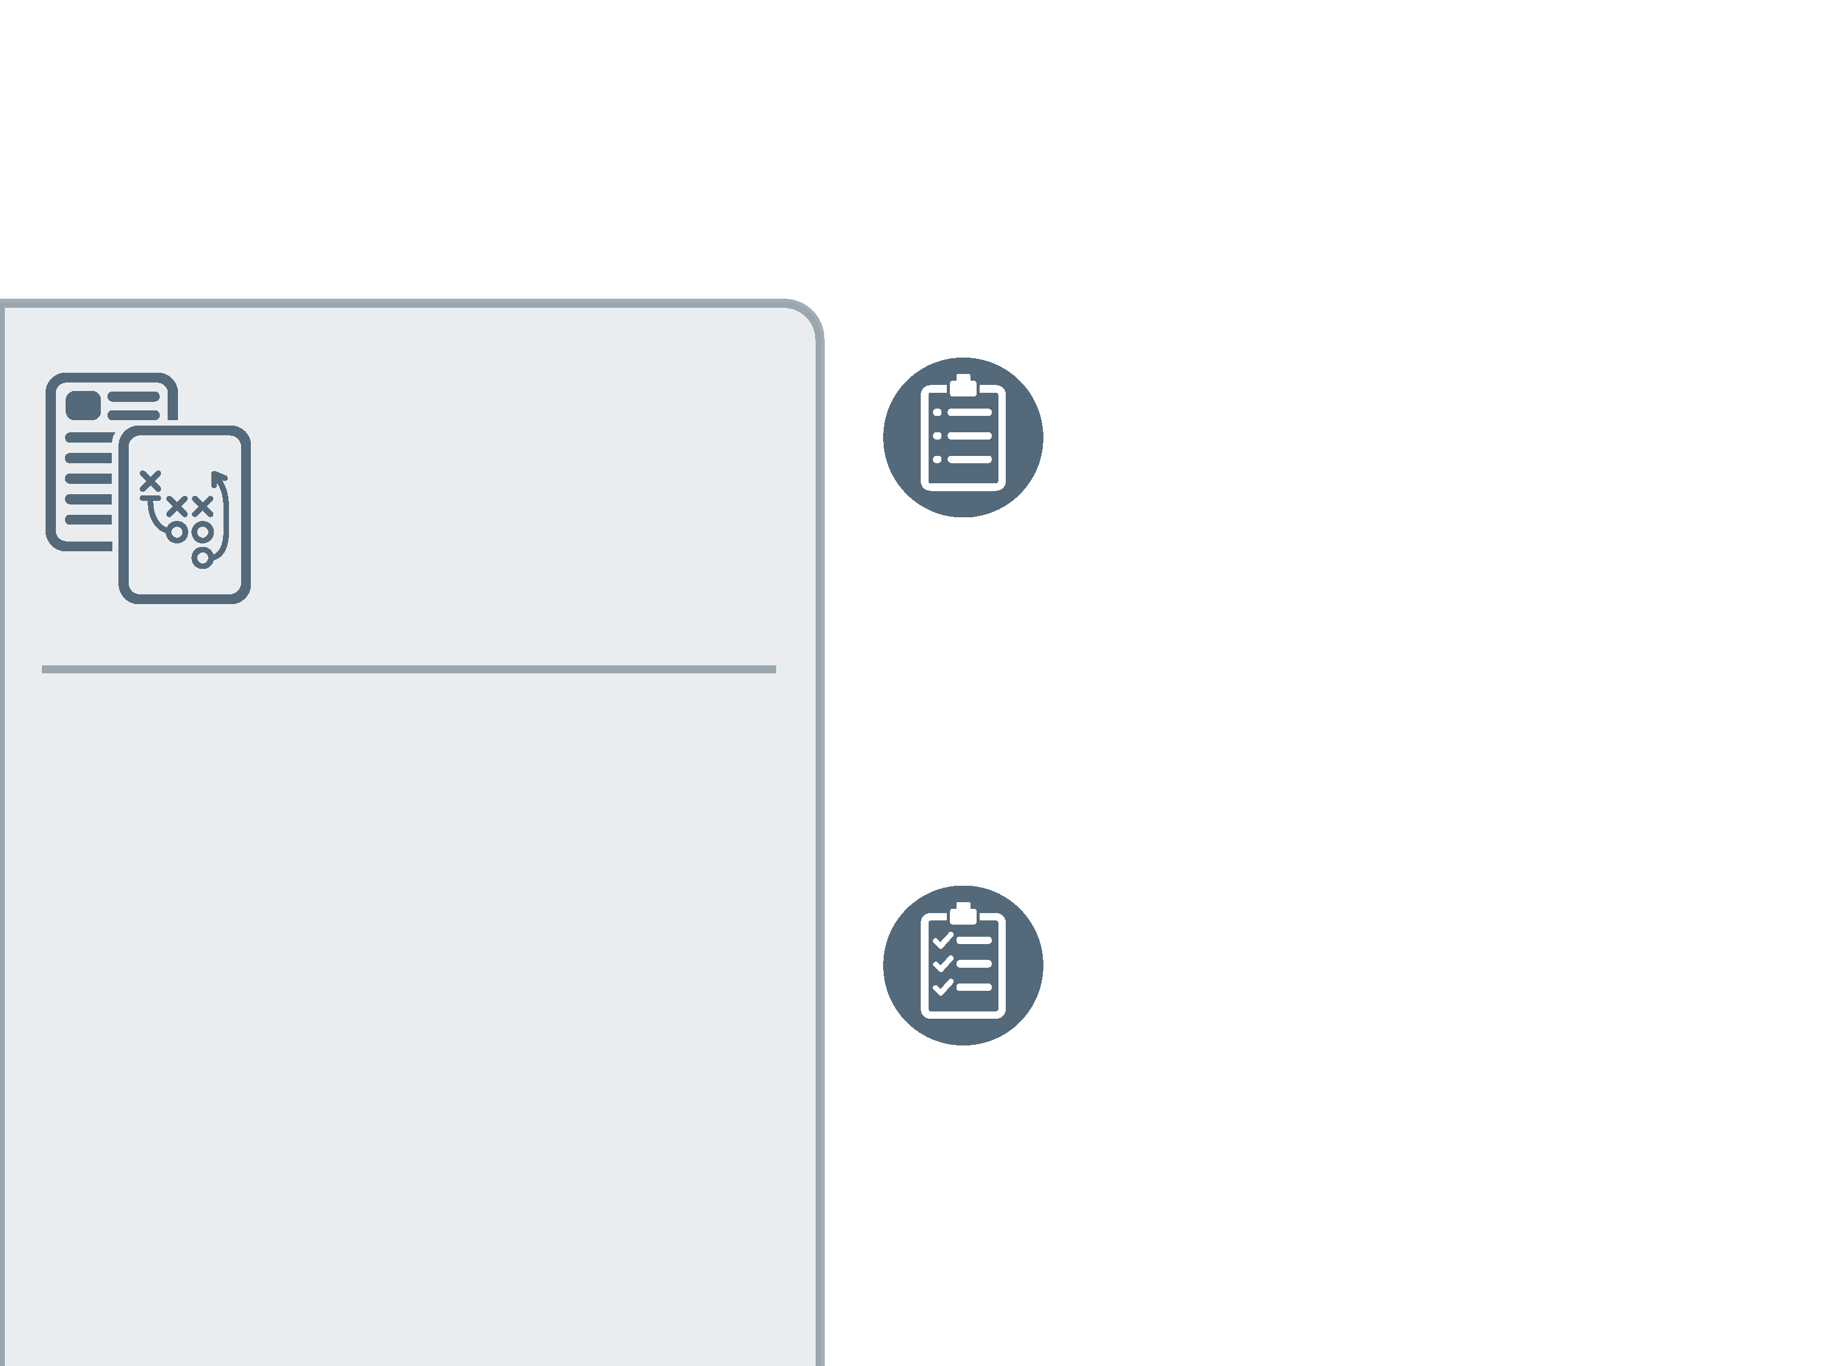
Coordinating the federal government’s response to incidents
Planning Documents and Exercises
Roles and Responsibilities in cyber incident response of the Federal Government, the private sector, and SLTT governments and how the government will organize its activities to manage the effects of significant cyber incidents.
National Cyber Incident Response Plan (NCIRP)
Lessons Learned from exercises, real world incidents, and policy and statutory updates, such as the PPD-41 and amendments to the Homeland Security Act.
26

Slide 28
Information Sharing and Technical Assistance Involving Federal and Non-Federal Entities
In addition to being authorized by statute, the Department’s actions must be:
Consistent with the Fourth Amendment to the U.S. Constitution.
Comply with criminal prohibitions, and The Wiretap Act, Pen/Trap Act, Stored Communications Act, and Computer Fraud and Abuse Act.
Use available funding under relevant Congressional appropriations.
Requests for Technical Assistance – private sector
Federal Network Authorization – civilian government agency
In some cases, the NCCIC must seek and obtain the consent of the entity’s network users, prior to connecting to an entity’s network, deploying technical capabilities on an entity’s network, or capturing network traffic. (i.e. banners)
CONSENT

